Slide 1
Microsoft Loop
🌟 A new star is born on the Microsoft 365 heaven 🌟

Slide 2


Andreas Hähnel
Microsoft Fanboy
M365 Understander
Cloud Architect
Managing Director
💖 PowerShell 💖
🧙‍♂️ MSP Designer & Developer 🧙‍♂️
Connect with me:
Notes:
Vorstellung – wer bin ich, was bin ich, wo bin ich, warum bin ich
Regelmäßige Projekte Domino -> M365
Ich baue meine Sessions "von 0 auf", d.h. ich rede immer kurz über die absoluten Grundlagen

Slide 3
What exactly is Microsoft doing?
… and why?
… and how?

Slide 4
To be honest…
Collaboration today is very often not really “collaboration”
File version chaos
Email spam
Co-Authoring sometimes
Whiteboard sometimes
Email is often the central storage 🤮

Slide 5

Loop for the rescue!
Loop as new productivity cockpit
Loop = real-time collaboration
Loop as connector between apps

Slide 6








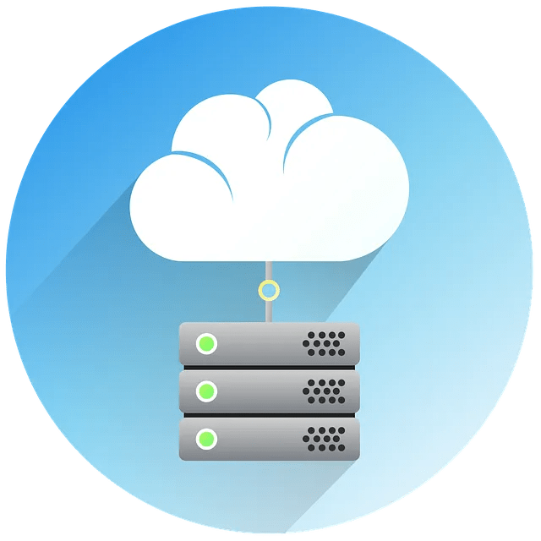


The Vision (visualized & simplified)

Slide 7
What does Loop offer?
Loop components
Loop pages
Loop workspaces
Dynamic "Text passage”
Live components
Fluid Framework
.fluid / .loop
Adaptive Cards
Single snippets
“Sheet of paper”
Notes
Loop components
Structured information
“Book”
Collection of pages
Structuring (chapter)

Slide 8
How to enable Loop
Loop Components in Teams
Step 1: SharePoint Online Admin PowerShell
Set-SPOTenant –IsLoopEnabled <$true|$false>

Slide 9
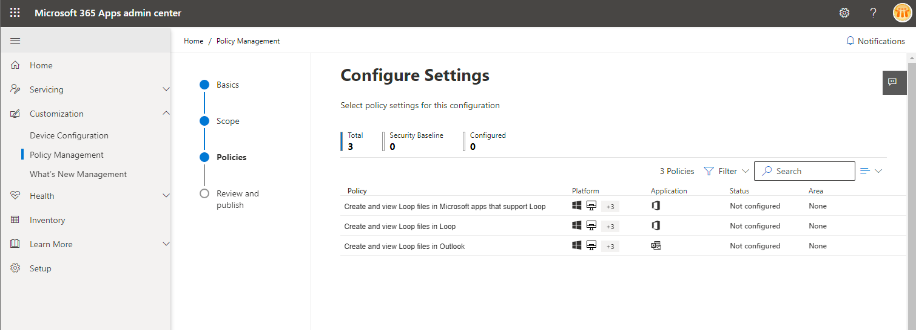
How to enable Loop
Loop app and integration with M365 apps
Step 1: AAD Group (Security / Dynamic / M365) for Pilot Deployment
Step 2: Exchange Online License
Step 3: Cloud Policy
Step 4: Patience

Slide 10
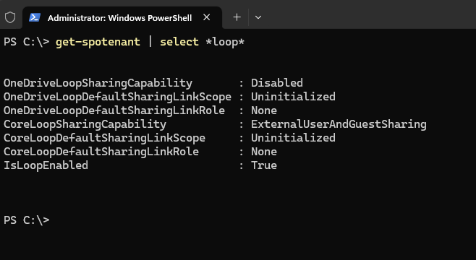
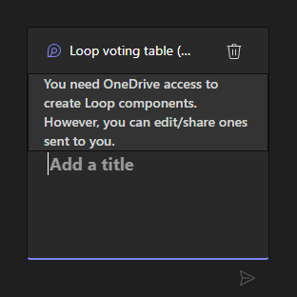
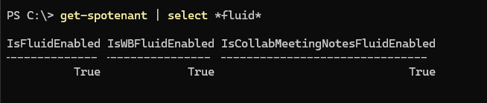
What should I know (technically)?
Loop runs on the Fluid Framework
Loop uses WebSocket technology for the real-time functions
Components are on by default
App is off by default
App has no retention policy support
There will be more….

Slide 11


Slide 12
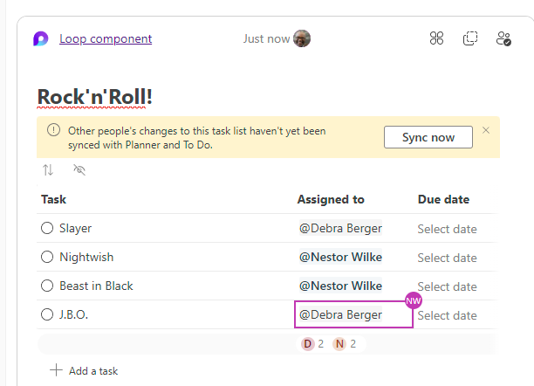
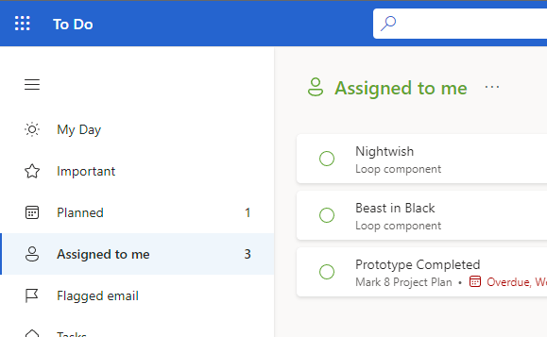
Some magical stuff

Slide 13
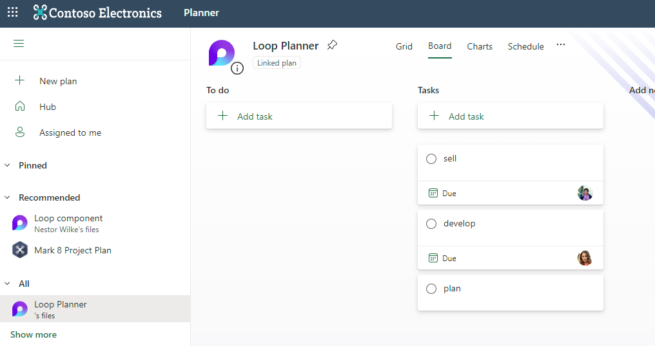
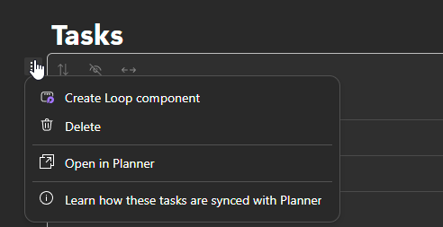
Some magical stuff

Slide 14
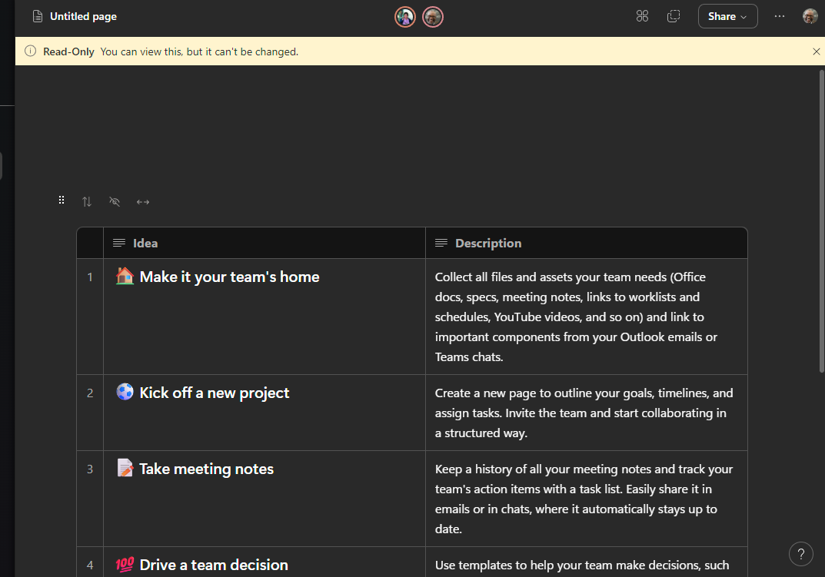
Loop Security
Read-only access
Sensitiy label support announced
DLP announced

Slide 15
Loop development 🪄🧙‍♂️
Loop Component Developer private preview running
GitHub integration announced
Pull requests
Issue information
SAPS4/HANA, Zoho SDP, Zoho Projects integration announced

Slide 16
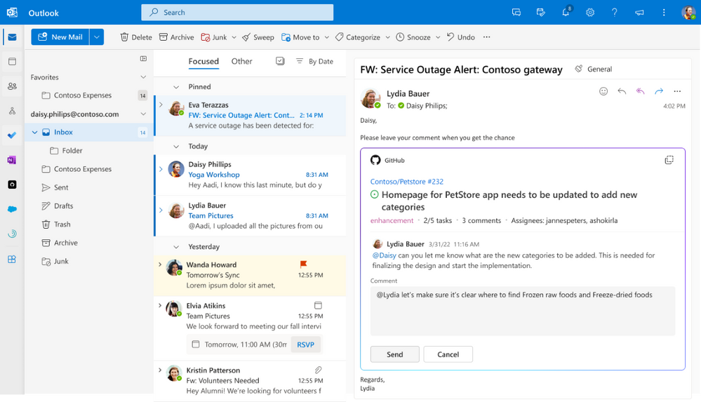

Slide 17


